Slide 1
Dynamic Sensor Networks
University of Adelaide

Slide 2
Desired Outcomes
Consolidated pictures of threat dispersion
Reduced need for specialist input
Networks and dynamic information architectures

Slide 3

A Mathematical Basis
Physical Models
Signal Processing
Statistical Models
Optimisation

Slide 4
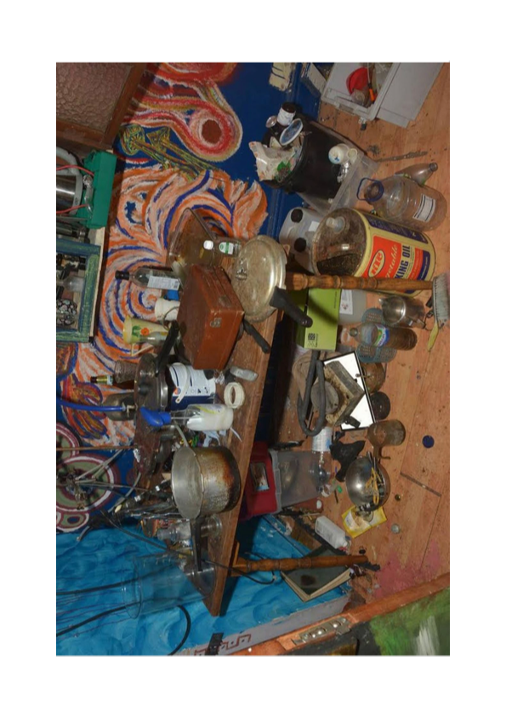

Slide 5
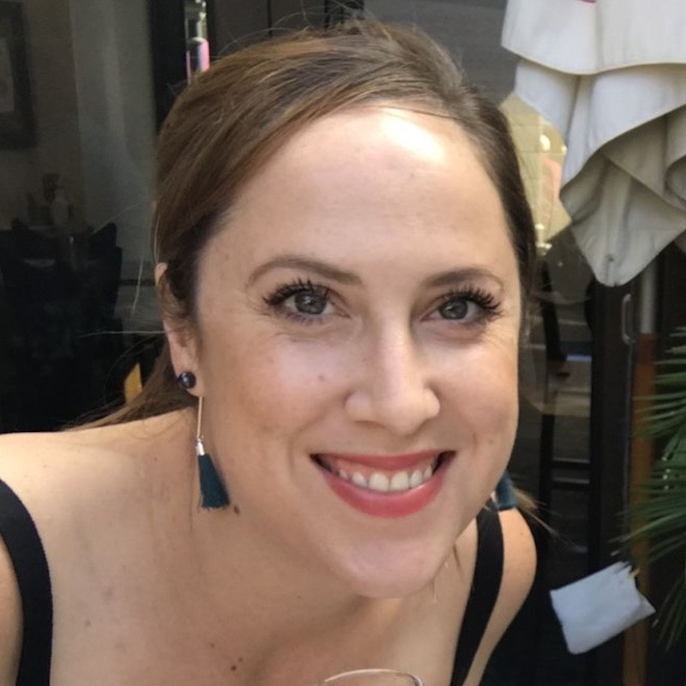

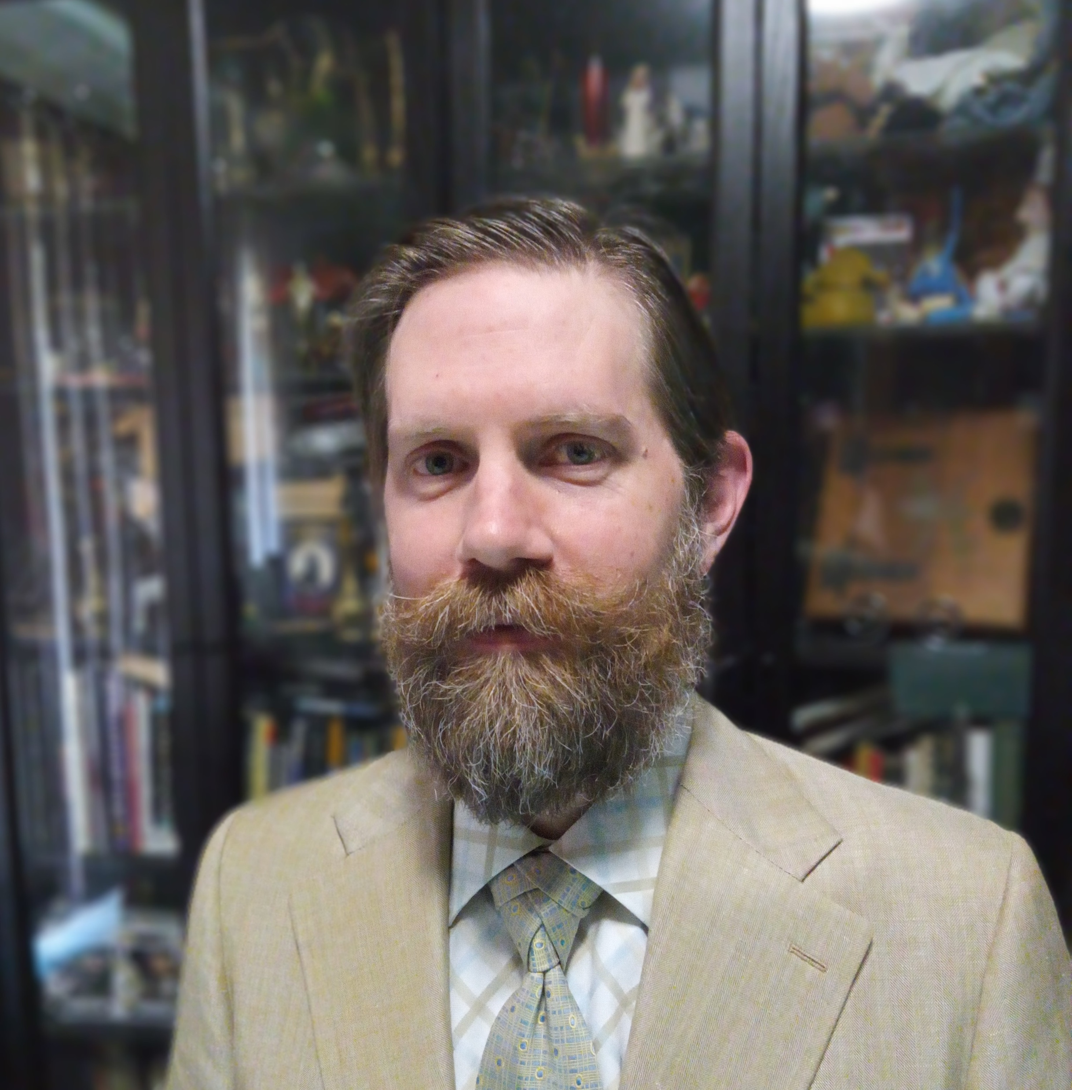
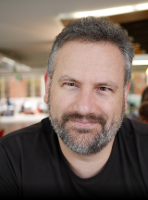


Evidence Triage
Digital twin
Probabilistic networks
Recommender systems

Slide 6
Evidence Triage

Slide 7
Strengths
Integrated Industry Partners
Solutions Focused
Flexible and Adaptive
Deep Capability
Collaborative Excellence

Slide 8
University of Adelaide’s Capabilities

Slide 9
Environment
Terrain:
  Mountainous, Hilly, Flat
  Desert, Forest, Tropical
Expertise:
  VR modelling
  Terrain Mapping

Slide 10


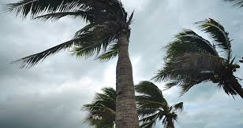

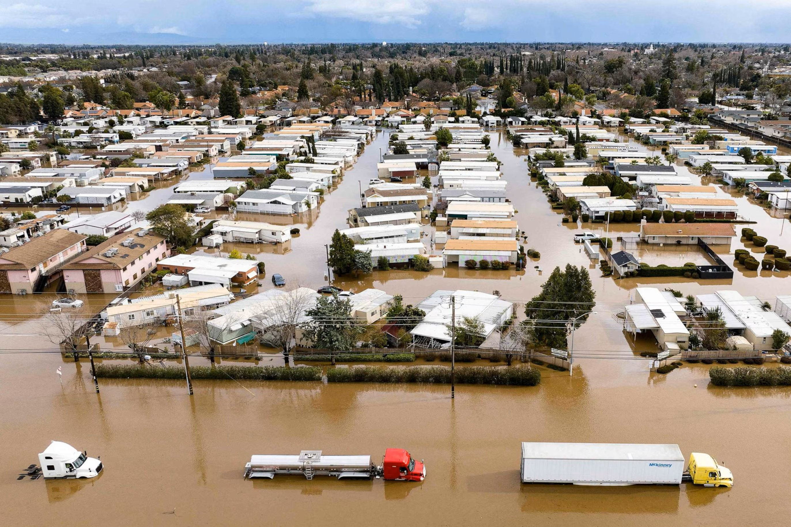
Weather
ENVIRONMENT

Slide 11
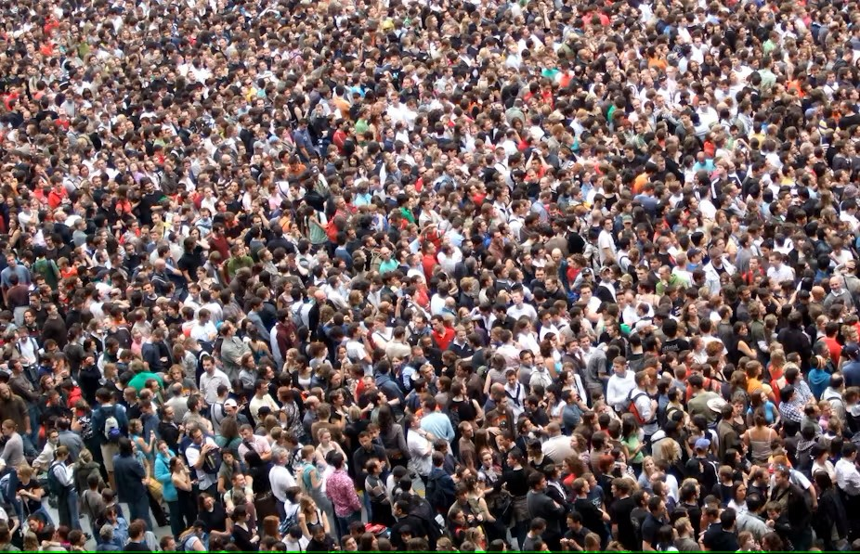
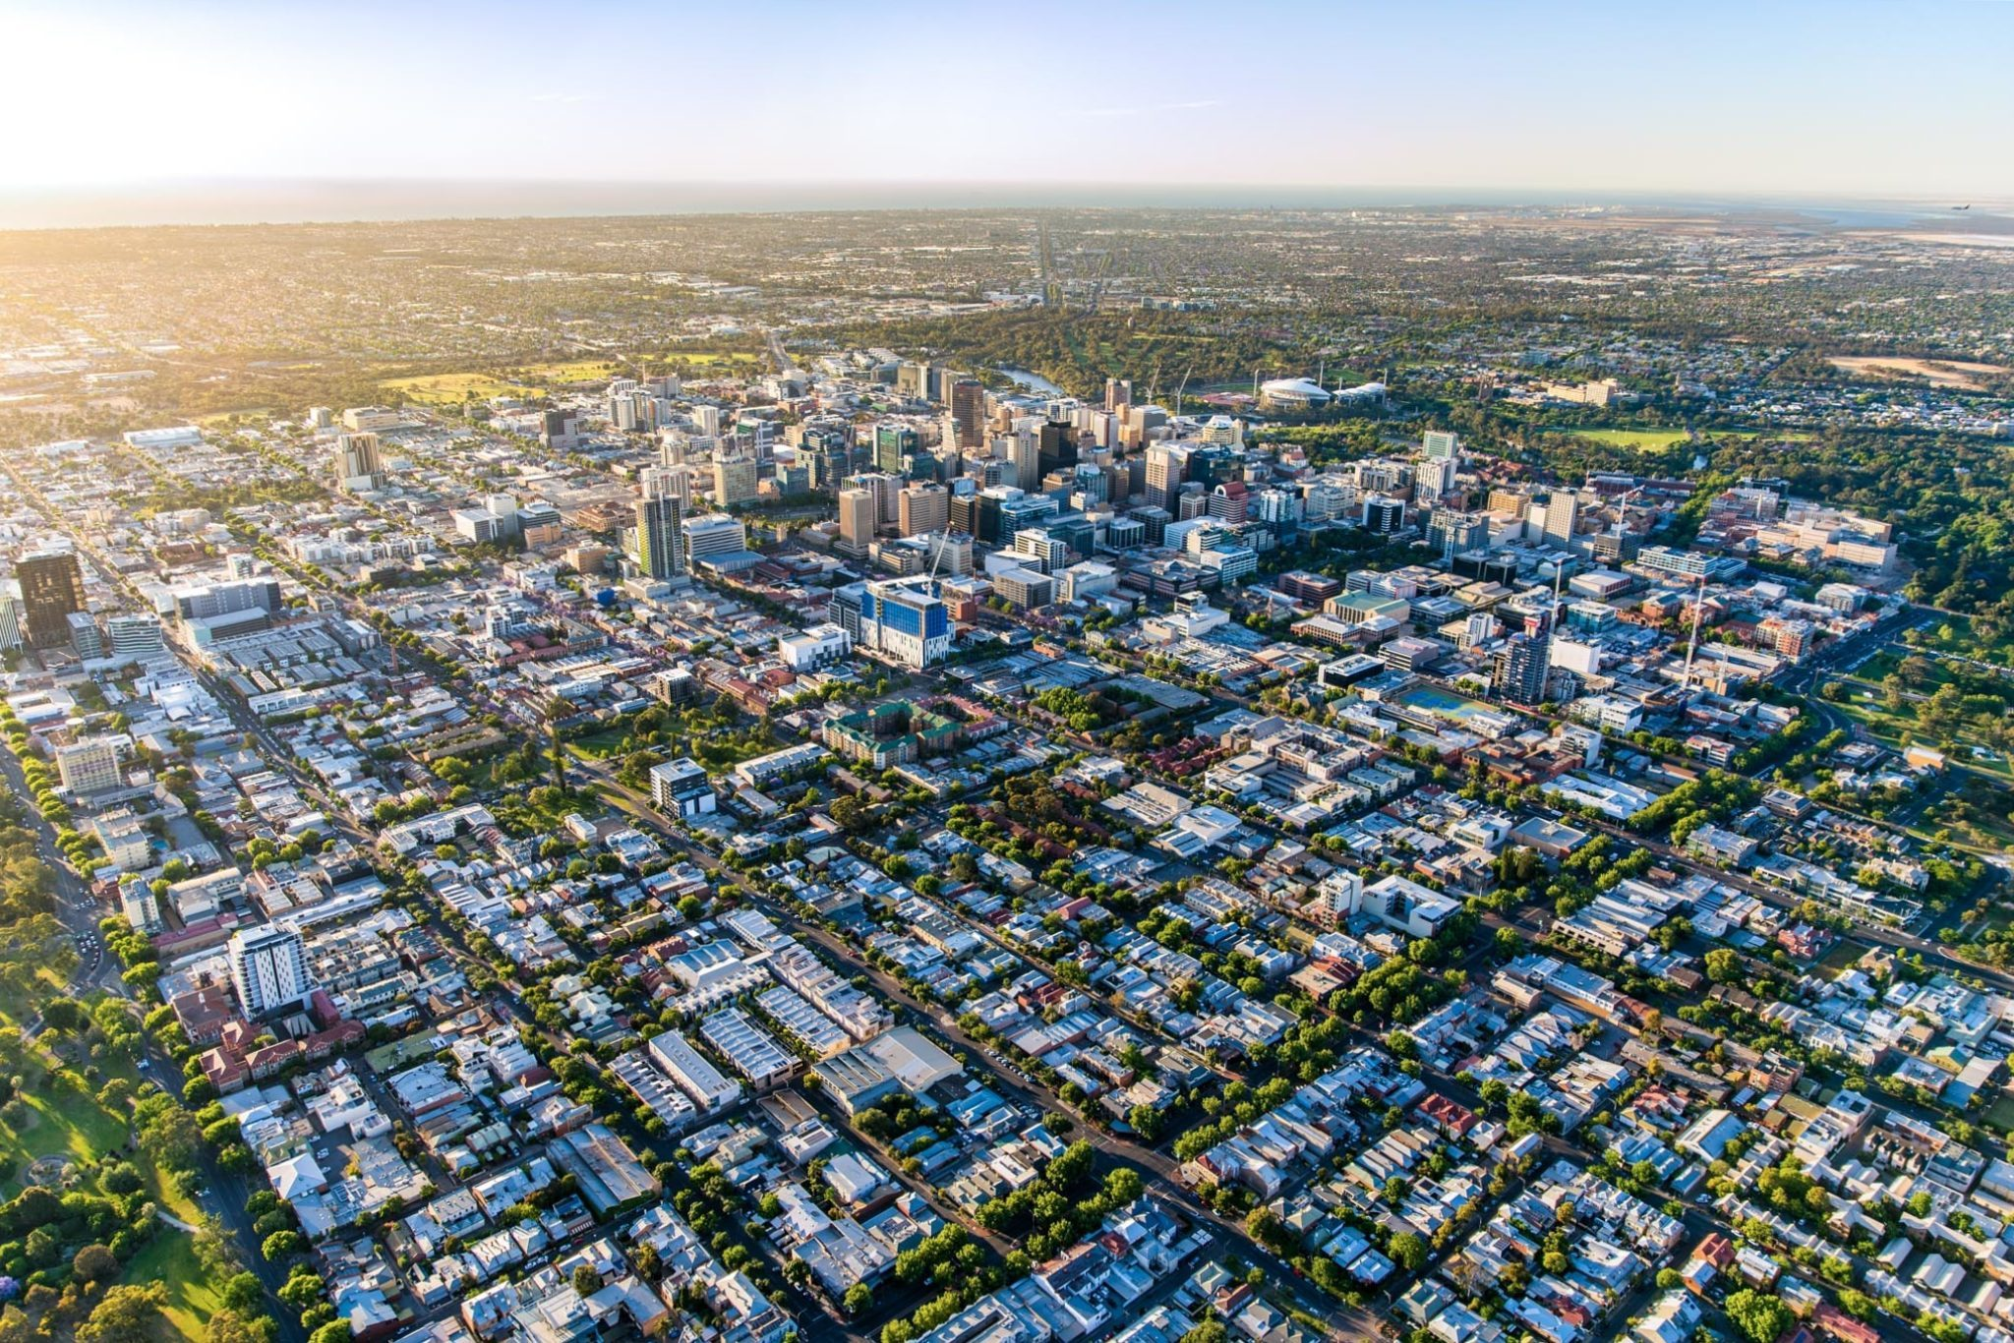
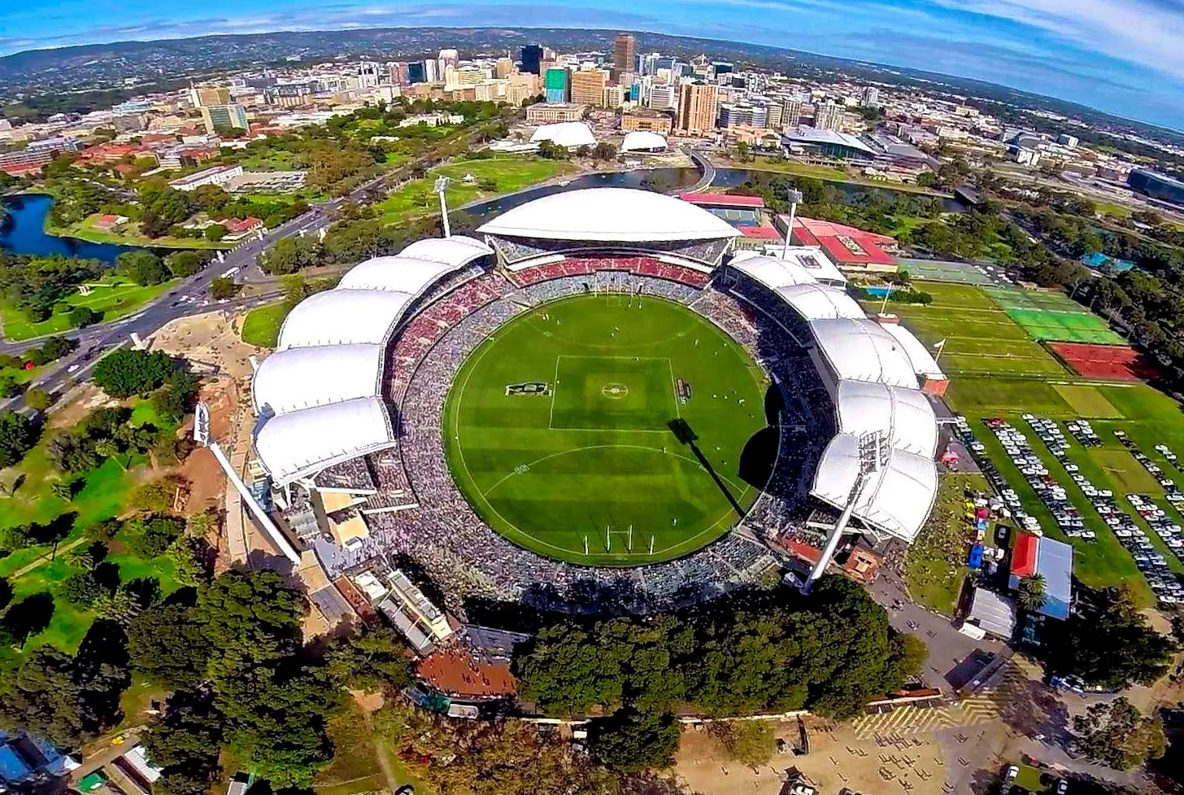

Urbanisation
Expertise:
  Crowd modelling
  Urban digital twins
  Wind turbine disturbance
WEATHER
ENVIRONMENT

Slide 12
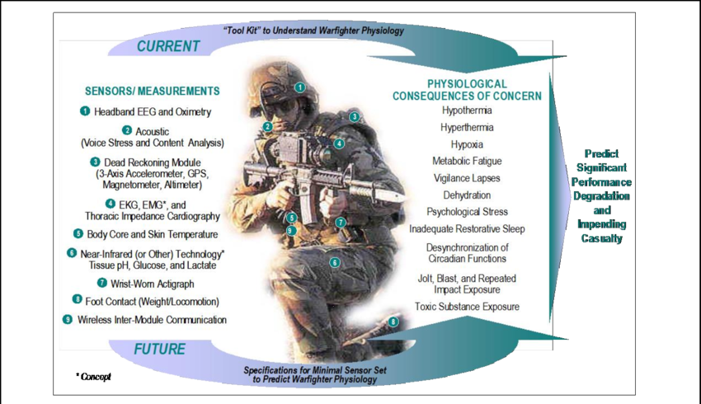
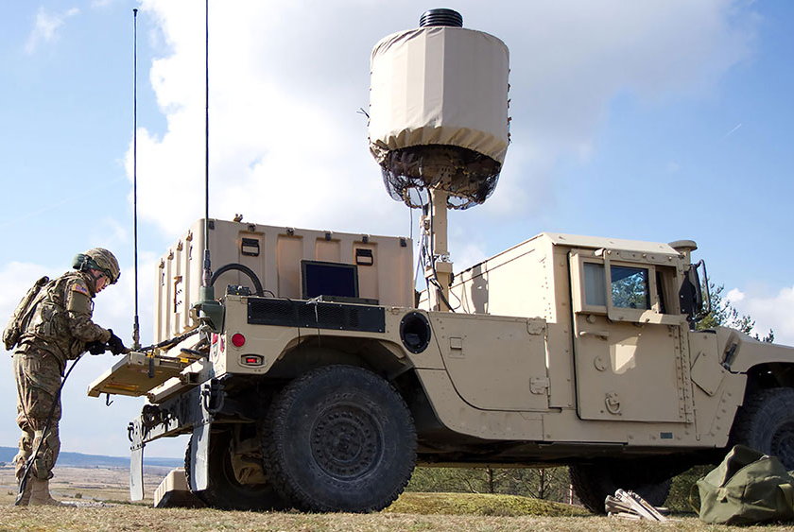
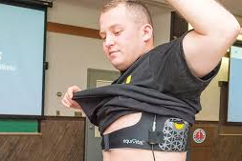
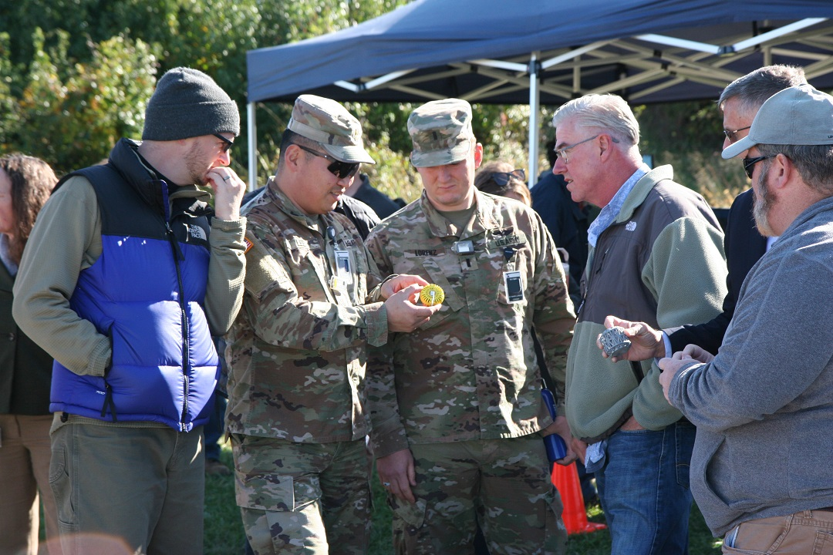
Sensors
Expertise:
  HISS – Human Integrated Sensor System
  KNOW
  Performance Patch
  AI – Sensor determination, Verification and Validation
  Quantum Sensors
URBANISATION
WEATHER
ENVIRONMENT

Slide 13
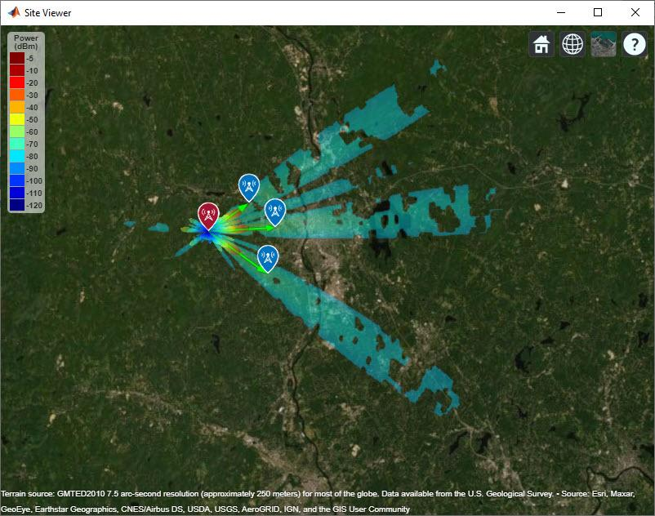

Data Collection
Expertise:
  RF Modelling
  AI Modelling of Dynamic Signals
  ADSC
SENSORS
URBANISATION
WEATHER
ENVIRONMENT

Slide 14


Data Analysis, Prediction, Simulation
Expertise:
  Statistical Modelling
  ML / AI / Advanced data analytics to find “shadows” of fast response in body’s systems response (brain, blood, etc)
DATA COLLECTION
SENSORS
URBANISATION
WEATHER
ENVIRONMENT

Slide 15
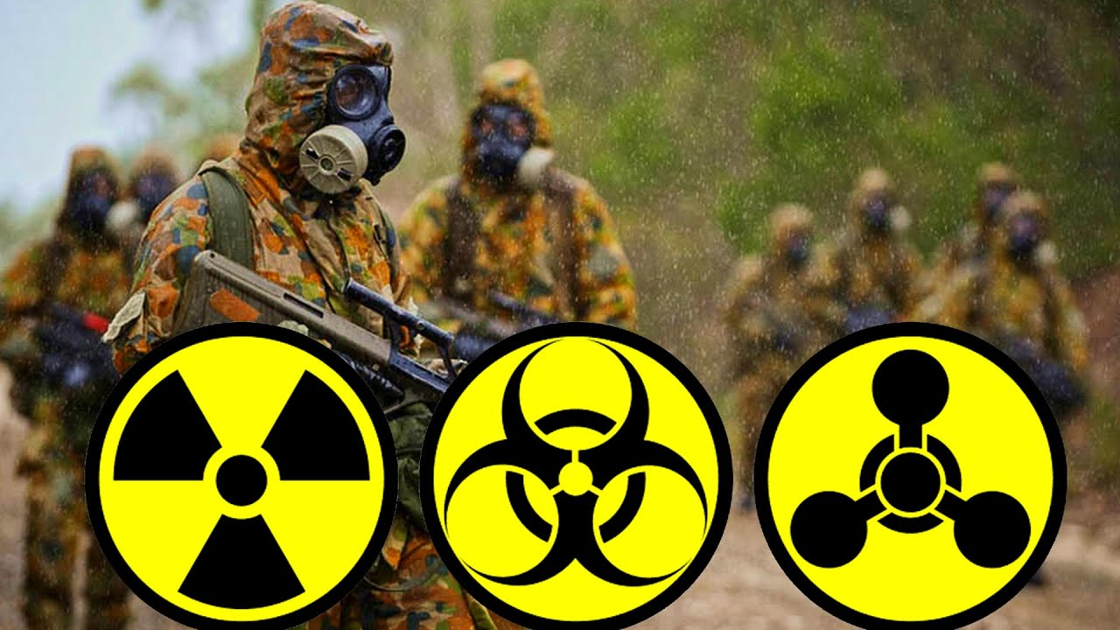



Expertise
Institutes
DATA ANALYSIS, PREDICTION, SIMULATION
DATA COLLECTION
SENSORS
URBANISATION
WEATHER
ENVIRONMENT

Slide 16





Partnerships
CADRE-OCE: Centre for Advanced Defence Research and Enterprise
  University of Melbourne
  Queensland University of Technology
  UNSW Sydney
  University of Adelaide
OCE-STaR Shot
  HISS –Human Integrated Sensor System (PP/KNOW)
  ACCESSS: Active Collaborative CBRN Sense and Sense-making System
  DAIRnet: Defence AI Research Network Project
SABRE Alliance
  Defence, Industry, Government, Academia
ARC Training Centre in Radiation Innovation
  Led by ANU in a partnership with UniSA and UoA

